Slide 1

The Financial Aid Director
Master of Multitasking

Slide 2
What we will be covering today
Master of multitasking
Human resource management
Federal Reporting
Daily Operations
Partnership with other campus teams
Interfacing with upper management

Slide 3

Managing Priorities
Prioritizing tasks
  Define your priorities from highest to lowest
    Daily
    Monthly
    Annual
  Factor the unexpected into your plan
    Employee absences
    Volatile student issues
    Demands from upper management
  Use your business model
    Anticipate the drama
      Peak processing issues
      Admissions expectations
  Create a compliance calendar
    List of all required campus reporting requirements
    Master calendar shared by other campus offices
    Used with project management software for resource management

Slide 4
Compliance Calendar Example
Type | Task Name | Finish | Owner
 | Annual Compliance Calendar | 2013
USED | FISAP Report | 9/30/13
USED | Federal Funds Reconciliation | 9/30/13
CSAC | CAL Grant Reconciliation | 9/30/13
USED | Crime Statistics Reporting | 9/30/13
USED | Net Price Calculator | 10/01/13
VA | VA Yellow Ribbon Request | 5/20/13
USED | Gainful Empolyment Disclosure Reporting | 9/1/2013
NCES | IPEDS SPRING | 4/10/2013
NCES | IPEDS WINTER | 2/6/2013
NCES | IPEDS FALL | 10/17/2013
BPPE | BPPVE Annual Report | 9/1/2013
NASAD | HEADS Data Survey | 1/31/13
NASAD | NASM Supplemental Annual Report | 10/15/13
NASAD | NASM Institutional Audit | 7/1/13
NASAD | ASCAP School Report | 13/1/13
USED | Federal Audited Financial Statements | 3/31/2013
USED | Annual Internal Federal Student Aid Audit | 3/31/2013

Slide 5

Defining Expectations
Who
  List of individuals that have expectations of you
  Prioritize this list by importance
  Identify the most effective communication style per individual
What
  Ask for a list of expectations from superiors and campus partners
  Request clarification of expectation for precise understanding if needed
  Communicate resources needed to meet expectations
  Identify technological needs and IT support
  Request additional support if needed to meet expectations
When
  Request dates and timelines of all expectations from superiors and campus partners
  Create calendars for all time frames and deadlines

Slide 6
Financial Aid Team Organization
    Match talent with Tasks
      Customer service skills matched with student facing positions
      Bilingual staff available for customer assistance
      Technically advanced staff in key processing position
      Quality assurance positions filled by detail oriented people
    Identifying staff resources for peak processing
      Incorporate peak processing time frames into master calendar
      Review past processing statistics for accuracy
      Partner with admissions for most up to date enrollment predictions
    Understanding training needs
      Conduct periodic file reviews for compliance training needs
      Monitor feedback from students and campus partners for customer service related training

Slide 7

Financial Aid Team Organization
Realistic staffing
  NASFAA Predictor Model
    Requires membership
    Calculates suggested staff numbers based on student population
    Create flow charts to map work flows
    Utilize orgcharts
Competitive recruiting
  CASFAA Jobs Link
  Higher Ed Jobs
  Chronicle of Higher Education
Consulting support
  Policy and procedure manual
  Policy development
Temporary staffing
  Peak enrollment periods
  Audit preparation
  Special assignments

Slide 8
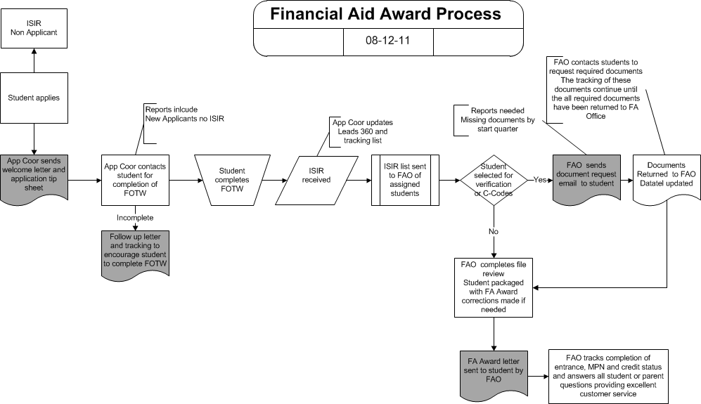
Financial Aid Team Organization
Process Flow Example

Slide 9
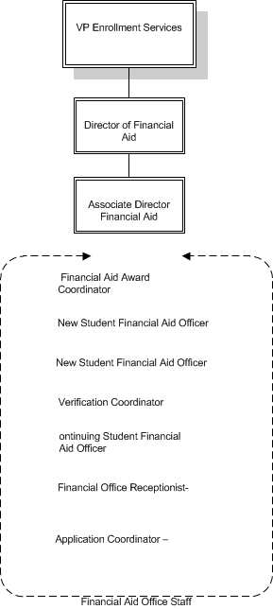
Financial Aid Team Organization
Org Chart Example

Slide 10

Financial Aid Team Organization
    Onboarding new staff
      Team interviews incorporating FA staff members
      Clearly defined list of expectations for position
      Hiring from within versus outside
    Discipline/Counseling staff issues
      Reviewing expectations of position
      Discussing staff member’s role in the office and team contribution
      Review of complaints from students or team members
      Evaluation of performance using statistical examples avoiding hearsay or gossip
      Document all counseling and coordinate with HR for all disciplinary actions
    Creating a fun team atmosphere
      Motivating staff through praise, appreciation and promotion
      Celebrating milestones, diversity, anniversaries and birthdays
      Frequent staff meetings with open discussion regarding policies and strategies
      Incorporate staff contributions into policy or procedural changes accepting all input

Slide 11

Regulatory Reporting
  State Reporting
    BPPE annual report (if applicable)
    School Performance Fact Sheets
    CSAC
  Federal reporting
    FISAP
      If campus is approved for campus based funds
    Monthly and annual federal funds reconciliation
      Coordination with fiscal office
      Documenting completion
    IPEDS
      Financial aid data collection
    SSCR
      Clearinghouse response reports
      3rd party servicer information provided
      Coordination with registrars office

Slide 12

Regulatory Reporting
    Net Price Calculator
      Annual updates on website
    Annual Crime Reporting
      Reported to the US Ed.
      Published on college website
      Included in annual notification
    Student Right to Know annual notification
      Basic financial aid information
      General information about the school
      Schools retention rate
      Drug and alcohol abuse policy
      Completion and graduation rate
      Placement and types of employment
      Types of graduate and professional programs that students completing a 4 year degree can obtain
      Family Educational Rights and Privacy Act
      Annual fire and safety reports

Slide 13

Daily Operations
Coordinating staff schedules
  Fair and equitable
  Best case scenario for everyone in the office
  Match schedules to specific needs of staff
Prioritizing regulatory requirements
  Timelines and deadlines
Campus partnerships
  IPEDS reporting
  Fiscal office reporting
  SAP
  SSCR

Slide 14

Daily Operations
Identifying student needs
  Application processing
    Support for students and parents
    Resolving PIN and processing issues
    Daily ISIR import
      Review of System generated ISIRs
Communicating effectively
  Notification of additional documentation
    Resolution of C-Comments
    Verification requirements
Follow up communications
  Emphasizing the need to meet processing deadlines

Slide 15

Daily Operations
Timely awarding
  Competitive award notification
  Equitable distribution of institutional and campus based aid
  Management of acceptance responses
  Coordination with admissions team
Timely disbursements and delivery of funds
  Sensitive to the needs of off campus students
  Clear communication regarding expected delivery dates
  Timely notification of disbursements
  Managing disbursement cancellation requests

Slide 16

Partnerships with Other Campus Teams
Identify shared reporting requirements
  IPEDS
  SSCR
    Clearinghouse rejected records
    NSLDS Submittal
  Gainful Employment
    Coordination of completion and placement statistics
  Student Right to Know annual notifications
    Campus Security Report
    Website updates
Communicating compliance updates
  Shared campus responsibilities
    Don’t shoot the messenger
Requesting automation or support from IT

Slide 17

Partnerships with Other Campus Teams
Registrar
  Updating student SAP statuses
  Monitoring students on appeal
Career Services
  Coordination of information with default prevention team
  Employment services for students on unemployment deferment
Admissions Team
  Partnerships include
    Sharing enrollment goals
    Identifying at risk prospects
    Managing institutional funding

Slide 18

Interfacing with Upper Management
Honest appraisal of staffing needs
  Temporary assistance during peak processing
  Budgetary guidelines for pay increases
Requesting support for automation
  New reporting requirements
  Updated communication
Strategic planning efforts
Policy and procedure updates
Compliance updates
Congressional initiatives
  Impact to higher education

Slide 19


Mentoring
Find a mentor
  Conferences
  List serves
  Association article
Be a mentor
  Share your expertise
  Train the next generation
Support your community
  CASFAA committees
  Support at conferences
  High school outreach
Networking
  Support is out there

